Slide 1
Intelligent Form Scanner
Yingxin Wei

Slide 2
Motivation & Goal
Information age
Computers & Smartphones
Handwritten documents
Optical character recognition (OCR)
Reading text from the paper and translating the images into a format that the computer can manipulate
Intelligent Form Scanner (Simplified OCR)
Convert the form with numbers inside from image format to electronic version
Enable users to harness the power of computer and smartphone to access documents with lots of handwritten digits
Paper -> Image -> CSV File

Slide 3
Approach
Extract the form from the image
Edge detection
Perspective warp
Detect the gridlines of the form by Hough transform
Extract the handwritten digits and do some processing
Recognize the handwritten digits with deep learning (CNN)
Use a csv file to record the digits in the form
“Beautify” the images that contain digits
“Rect” out the handwritten digits

Slide 4
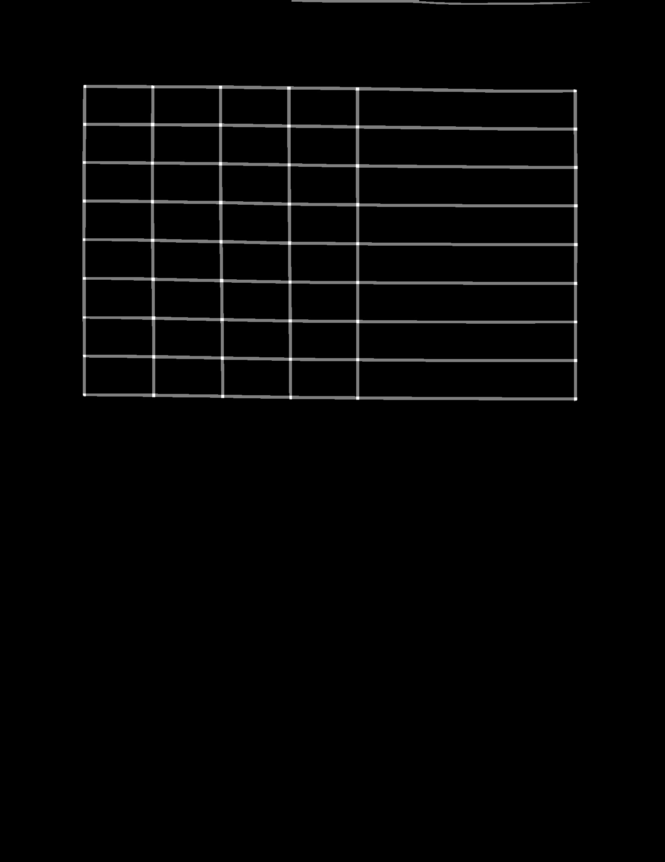
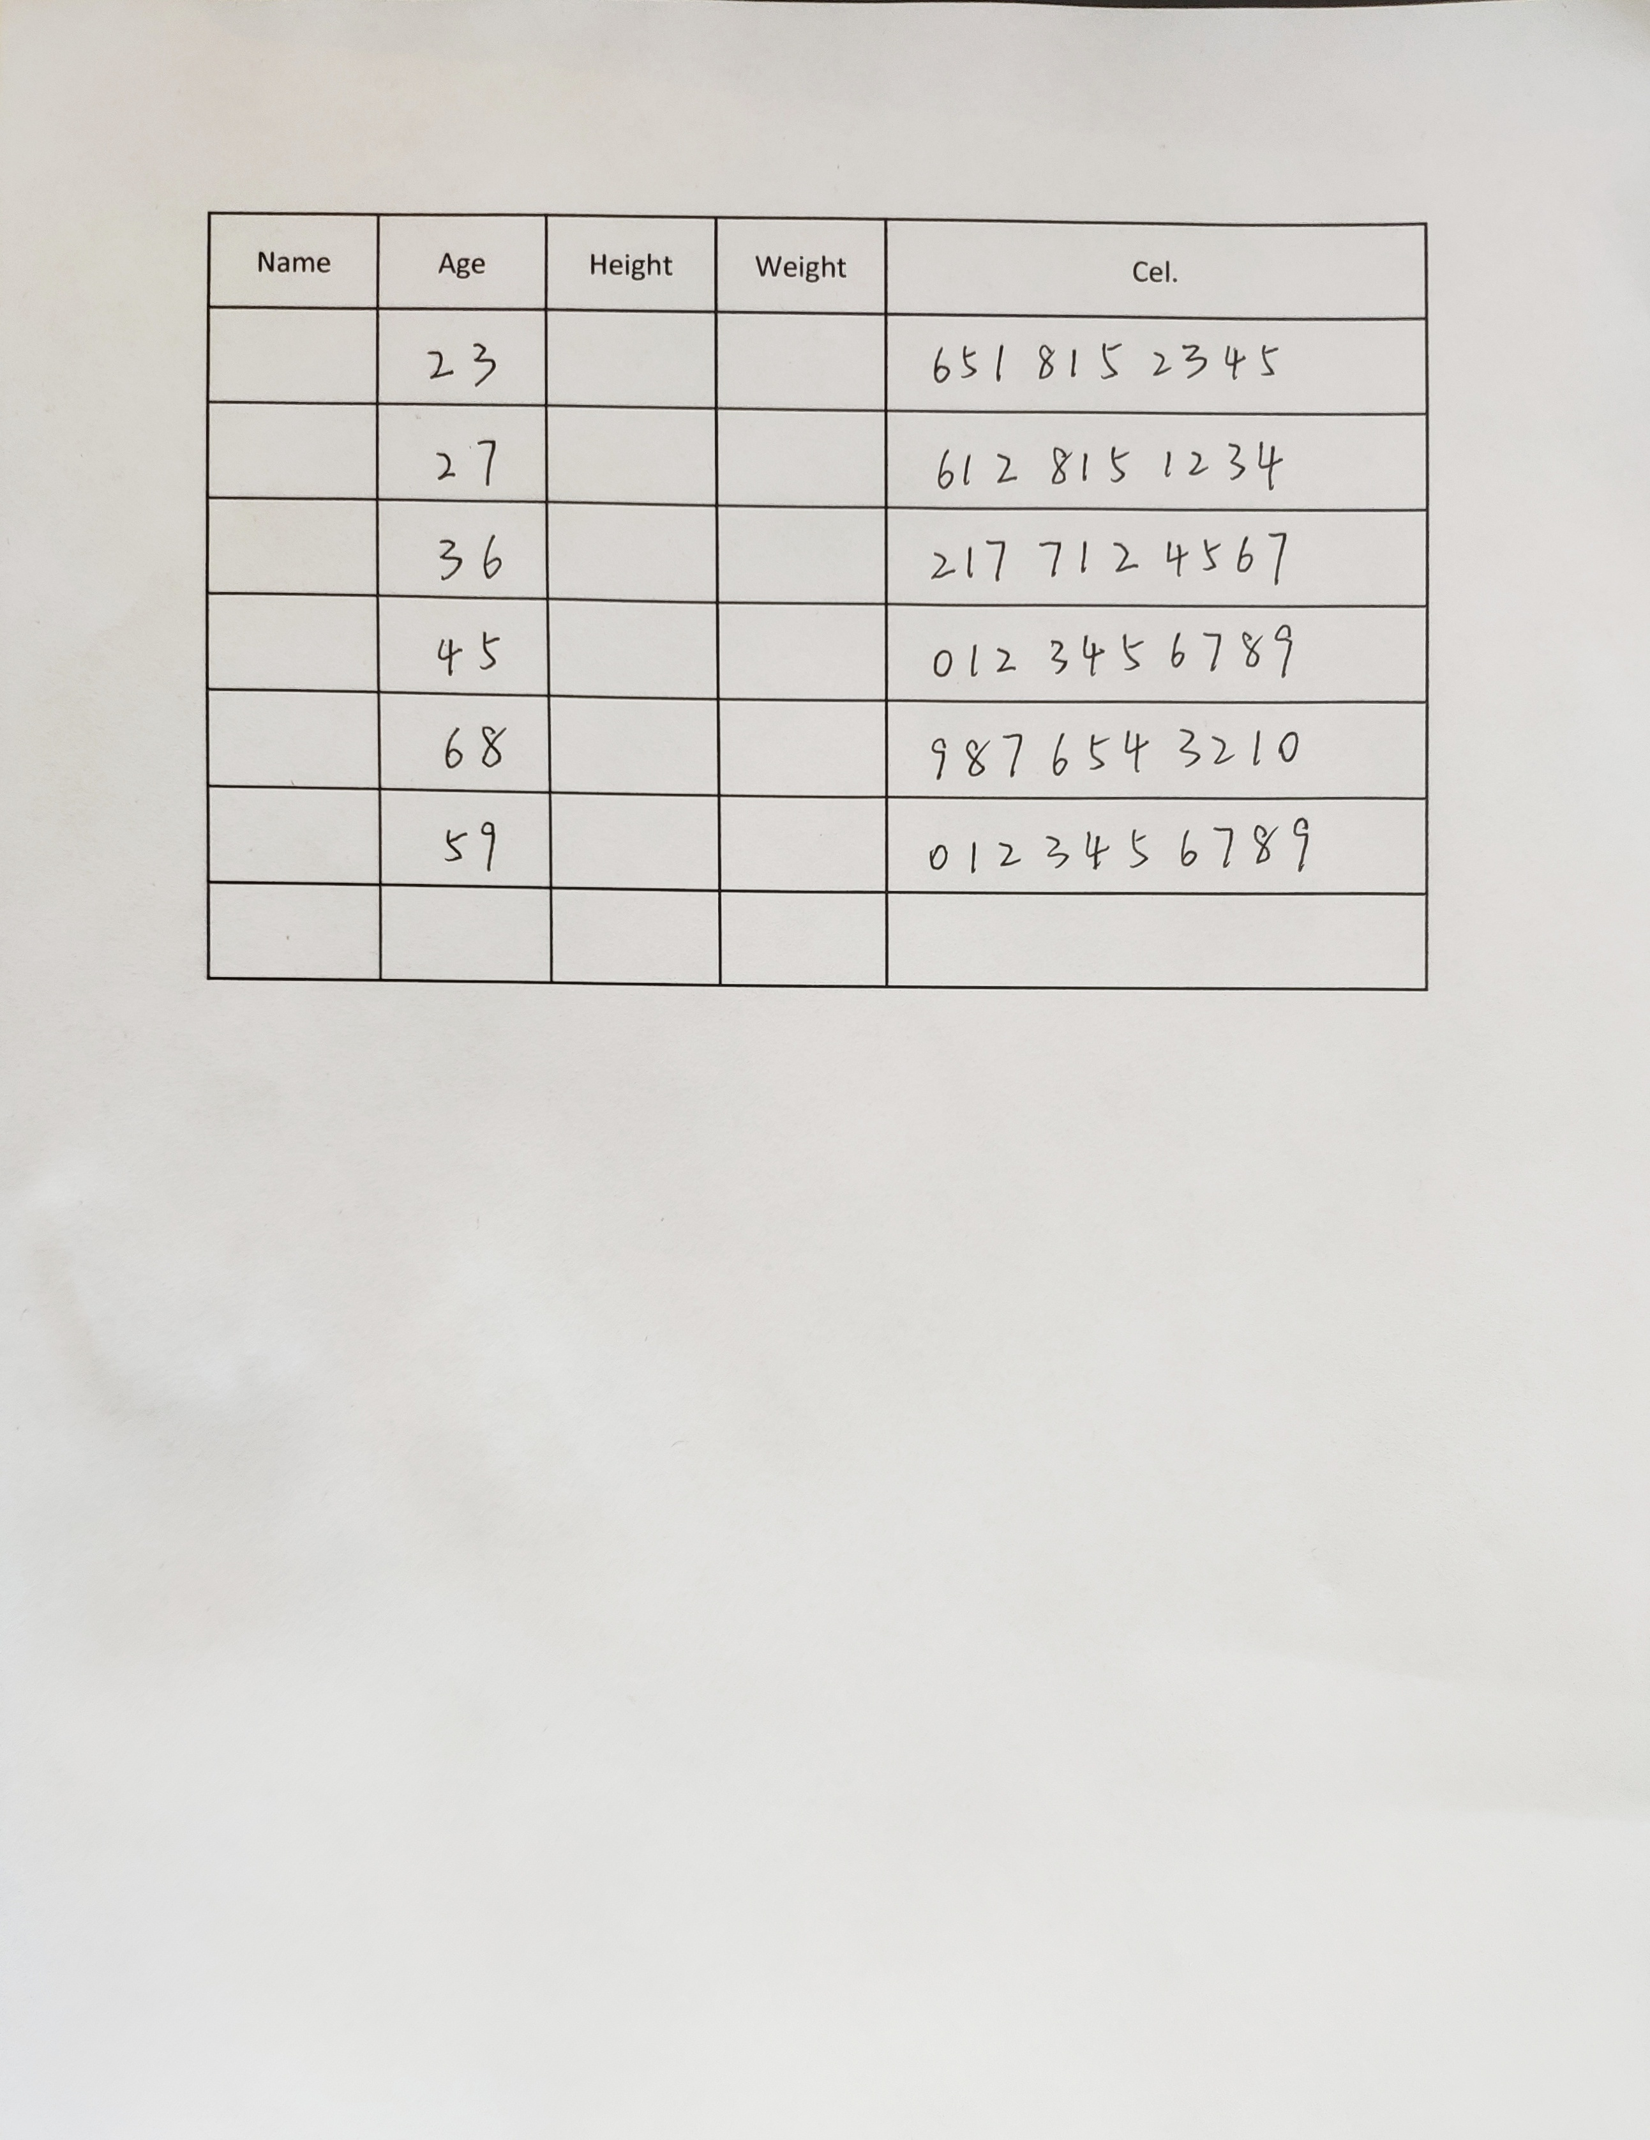
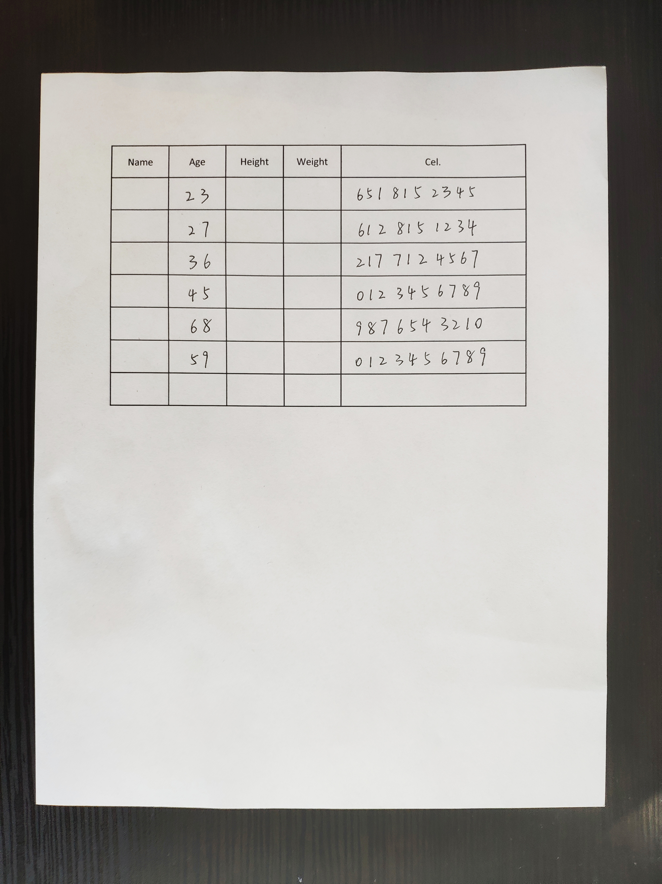
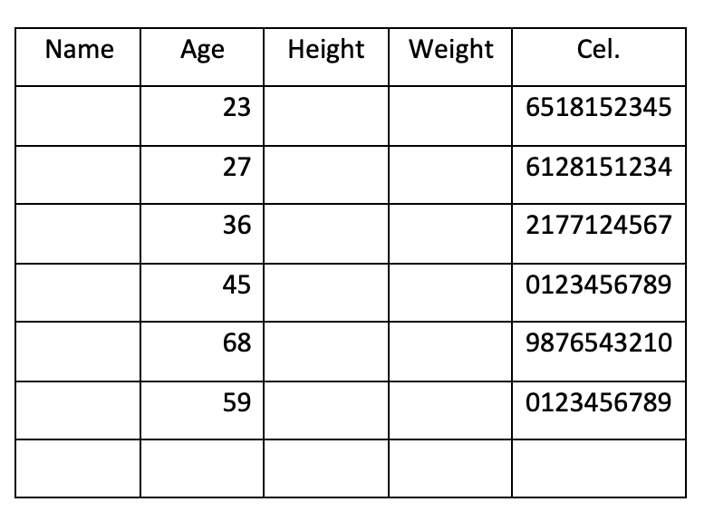
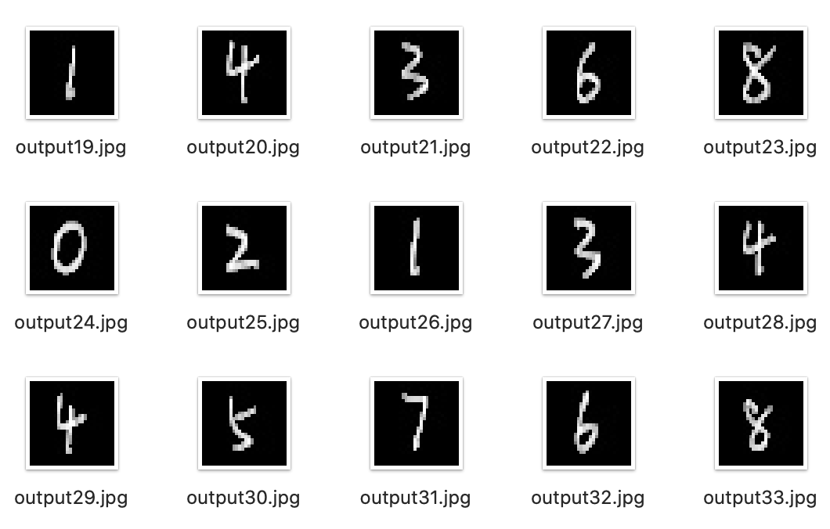
Results
Gridlines and
Extracted digits
Original image
Extracted form
Electronic form

Slide 5
Q&A
Thank you

